Slide 1
MBA652A Project 2
Ethereum Price Prediction
Submitted by:
Ashwani Prabhakar -18114006
Danish nawaz-18114008
Dhruv patel-18114014
Rohit gupta-18114020

Slide 2
INTRODUCTION
AIM : To predict the Ethereum prices for 45 consecutive days on the basis of data provided from April 2015 to april 2019.
Since the prices change on day to day basis, the data could be classified as Time Series.
This data is taken from coin marketcap.
https://coinmarketcap.com/

Slide 3
VARIABLE DESCRIPTION
The data consists of various attributes related to Ethereum prices in $ apart from the trading date and market capitalization viz.
Date
Open
High
Low
Close
Volume
Market Capitalization

Slide 4
Dependent and Independent Variables
Dependent Variable : Closing value of the Ethereum
Independent Variable: Time

Slide 5
Data preprocessing
Change regular expression and sorting based on date
Converting data from factor to integer.
Conversion to time series object .

Slide 6
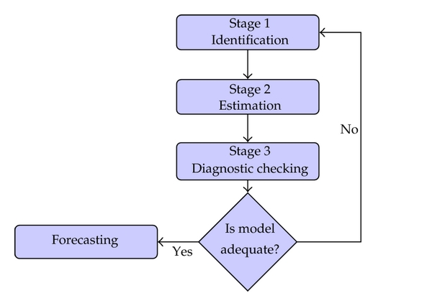
BOX-JENKINS Methodology:

Slide 7
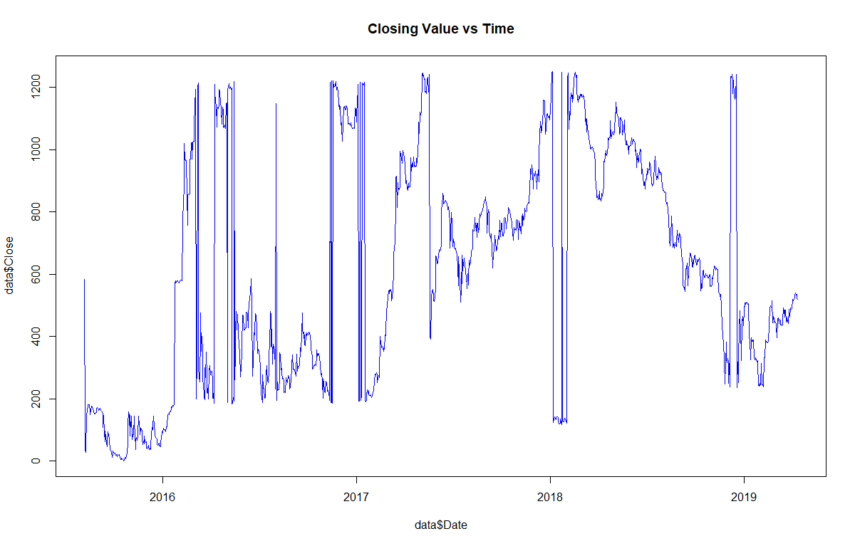
Closing Values vs time

Slide 8
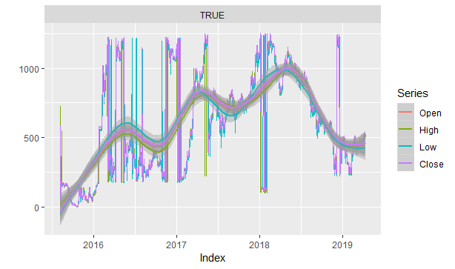
All attributes vs time

Slide 9
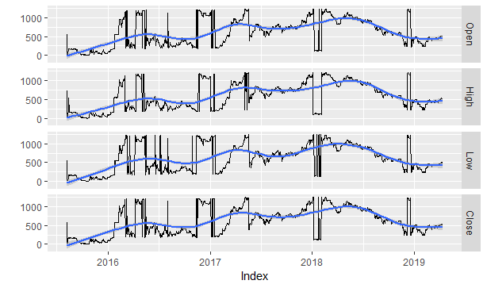
All attribute vs time

Slide 10
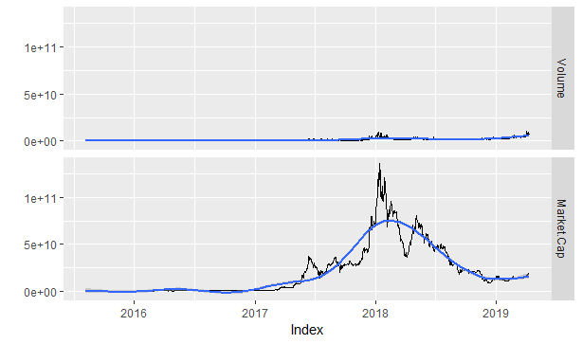
Market Cap & VOLUME vs time

Slide 11
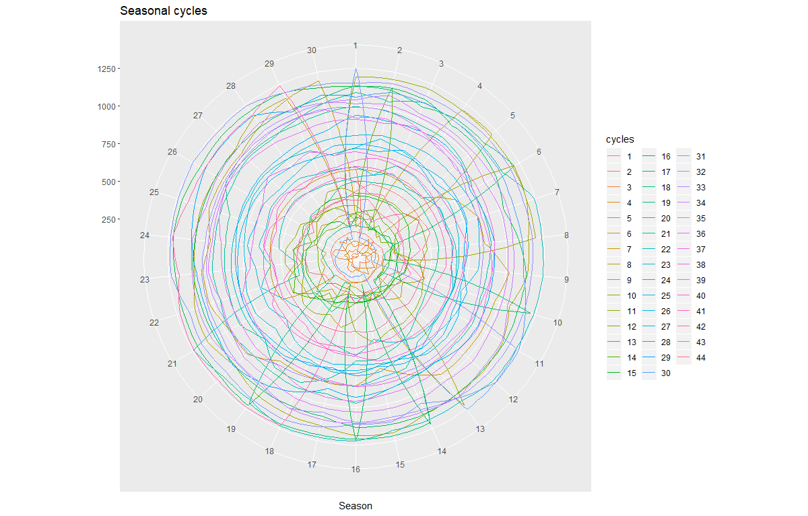
Seasonality check

Slide 12
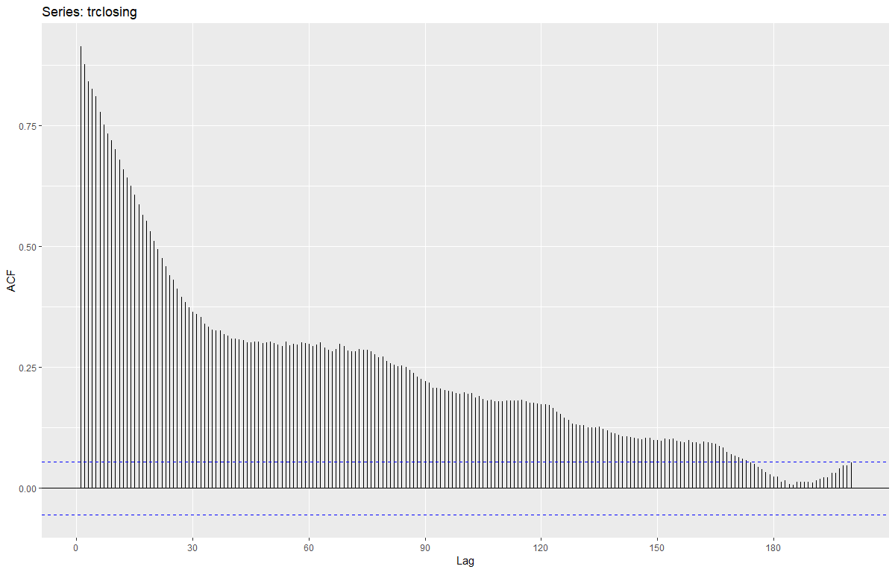
Autocorrelation Function of Closing Price (ACF PLOT)

Slide 13
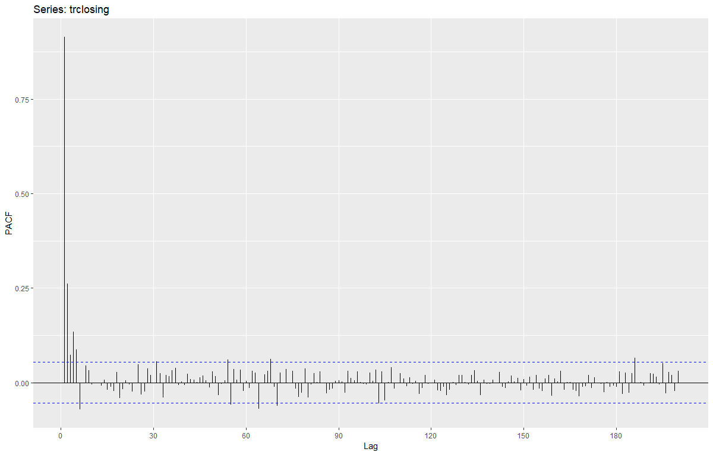
PARTIAL Autocorrelation Function of CloSING PRICE (PACF PLOT)

Slide 14
Ljung Test for serial autocorrelation
Box-Ljung test
data: data_t$Close
Chi-squared = 8632.3, df = 10, p-value < 2.2e-16

Slide 15
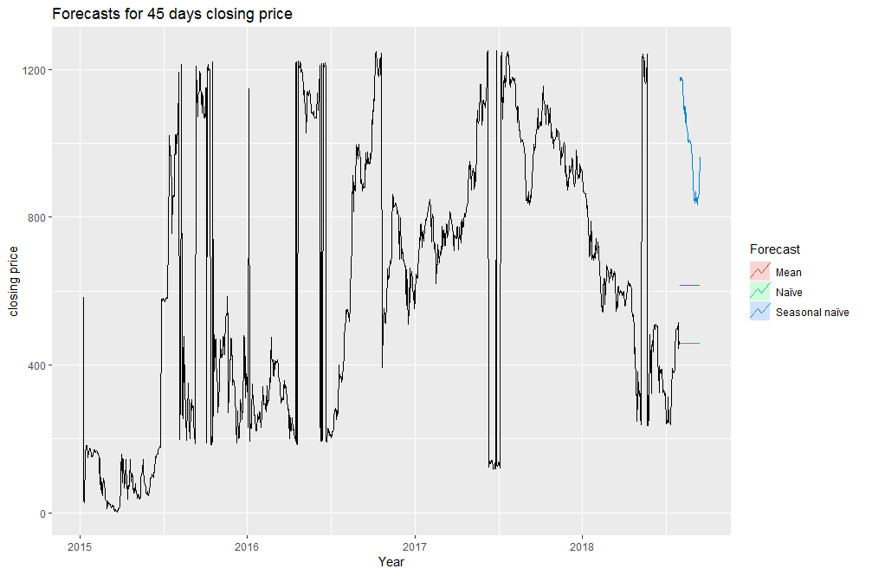
Simple forecasting technique

Slide 16
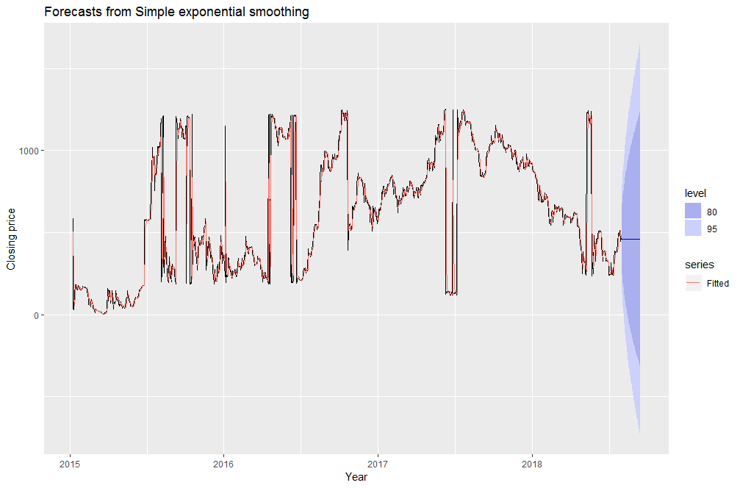
Exponential smoothing
Notes:
Alpha=0.61

Slide 17
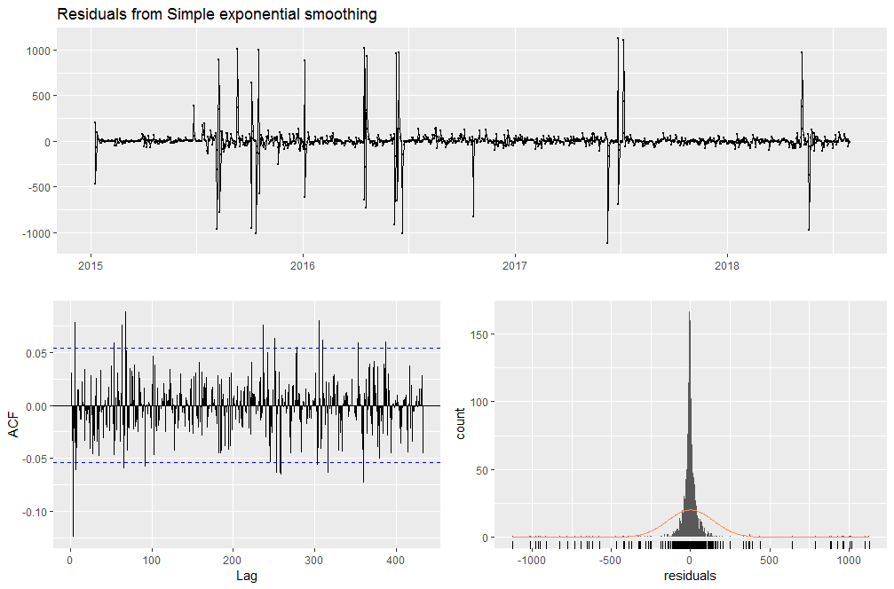
Residual plot

Slide 18
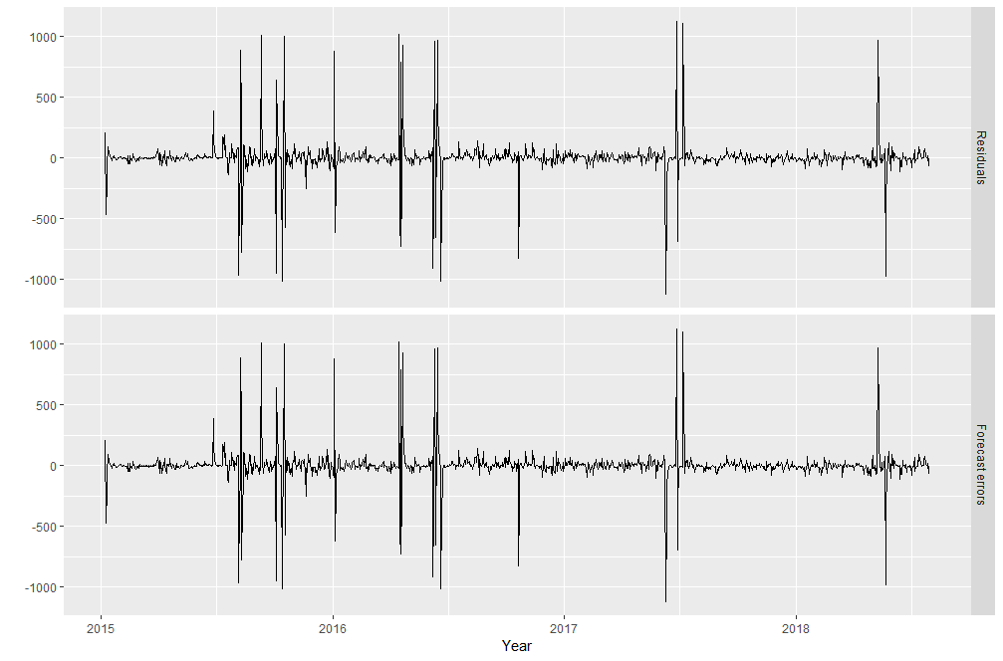
Residual vs one step forecast error (POOS)

Slide 19
ADF Test
Index no. | Variable | P-Value | Dickey-fuller value
1 | Close | .99 | 1.0896
2 | Difference(close) | .2295 | -2.8241
3 | log of close | .99 | .56
4 | difference of Log of close | .08411 | -3.2221

Slide 20
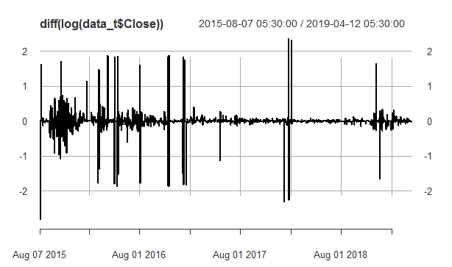
Diff(Log(close)) vs time

Slide 21
AIC AND BIC FOR LAG VALUES:
LAG | A1C | B1C
1 | 16718.11 | 16733.62
2 | 16626.68 | 16669.36
3 | 16621.18 | 16647.03
4 | 16599.01 | 16630.03
5 | 16590.79 | 16626.98
6 | 16586.41 | 16630.77

Slide 22
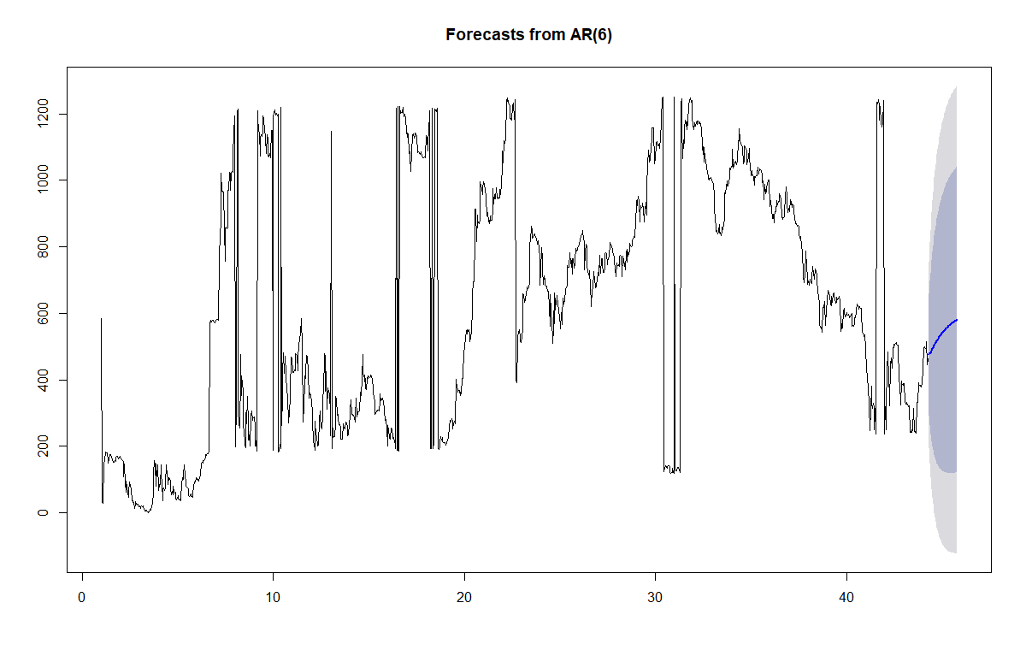
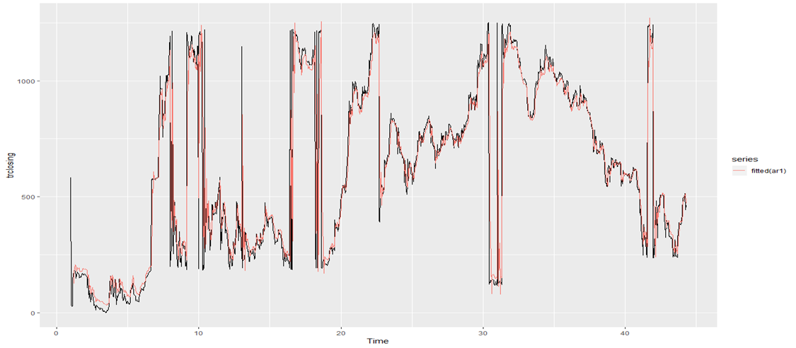
Autoregressive Model ar[6] Forecast :

Slide 23
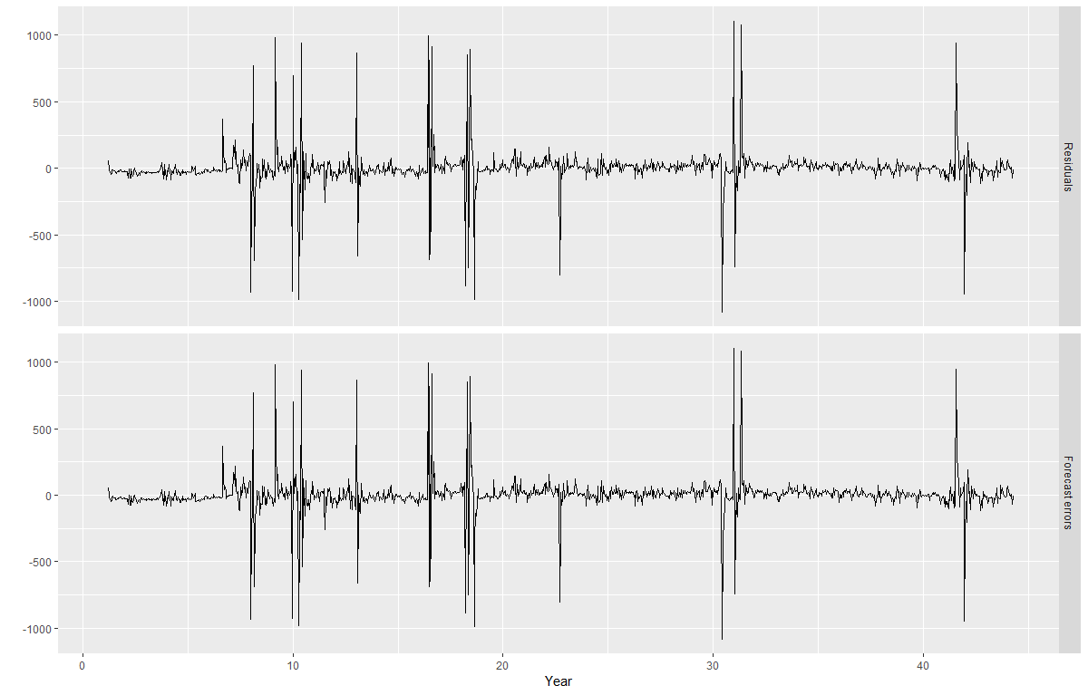
Autoregressive model Residual vs one step forecast error (POOS)

Slide 24
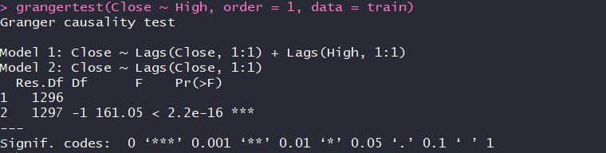
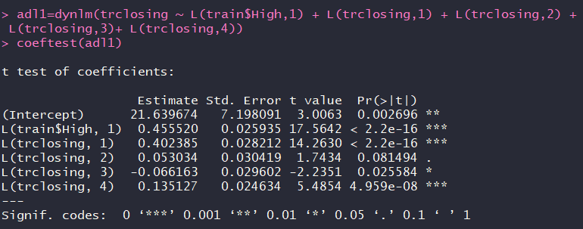
Granger causality test and Adl(4,1) model with High values as independent variable

Slide 25
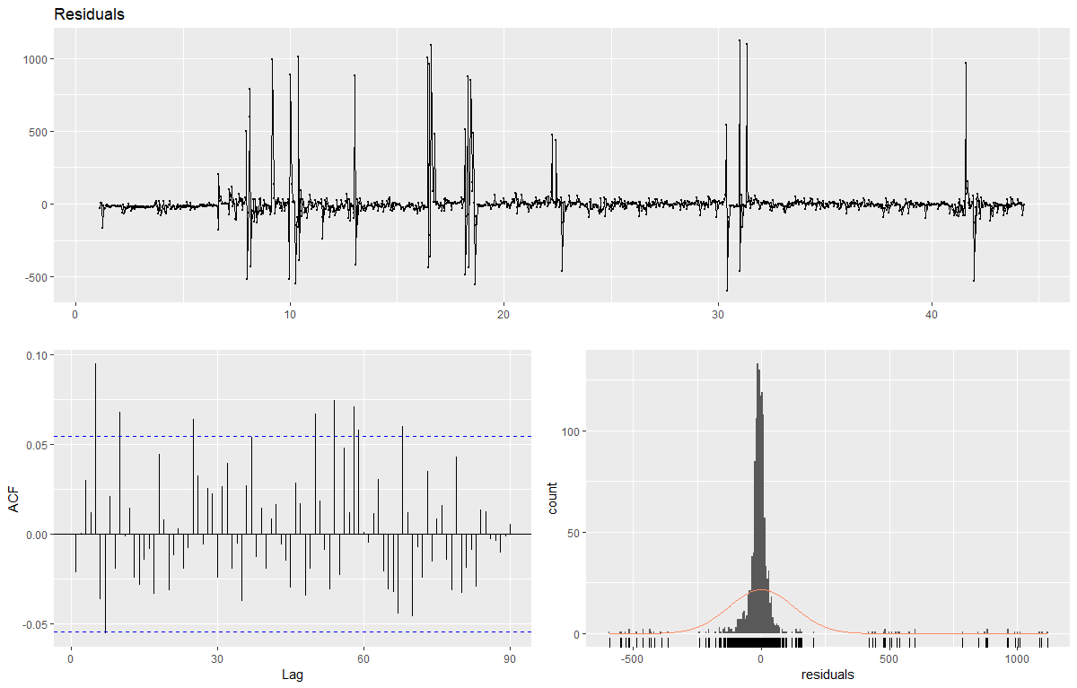
Adl[4,1] residuals:

Slide 26
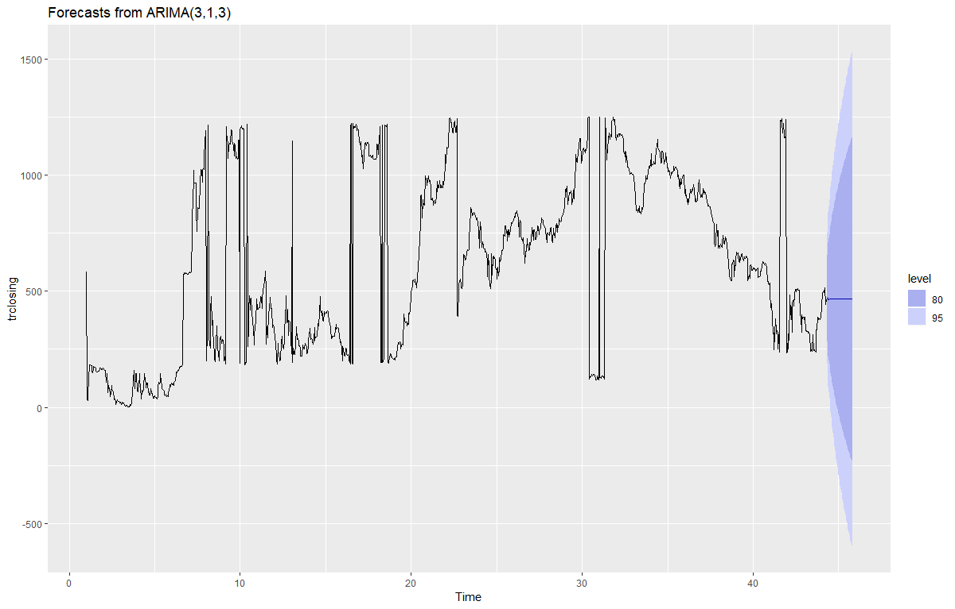
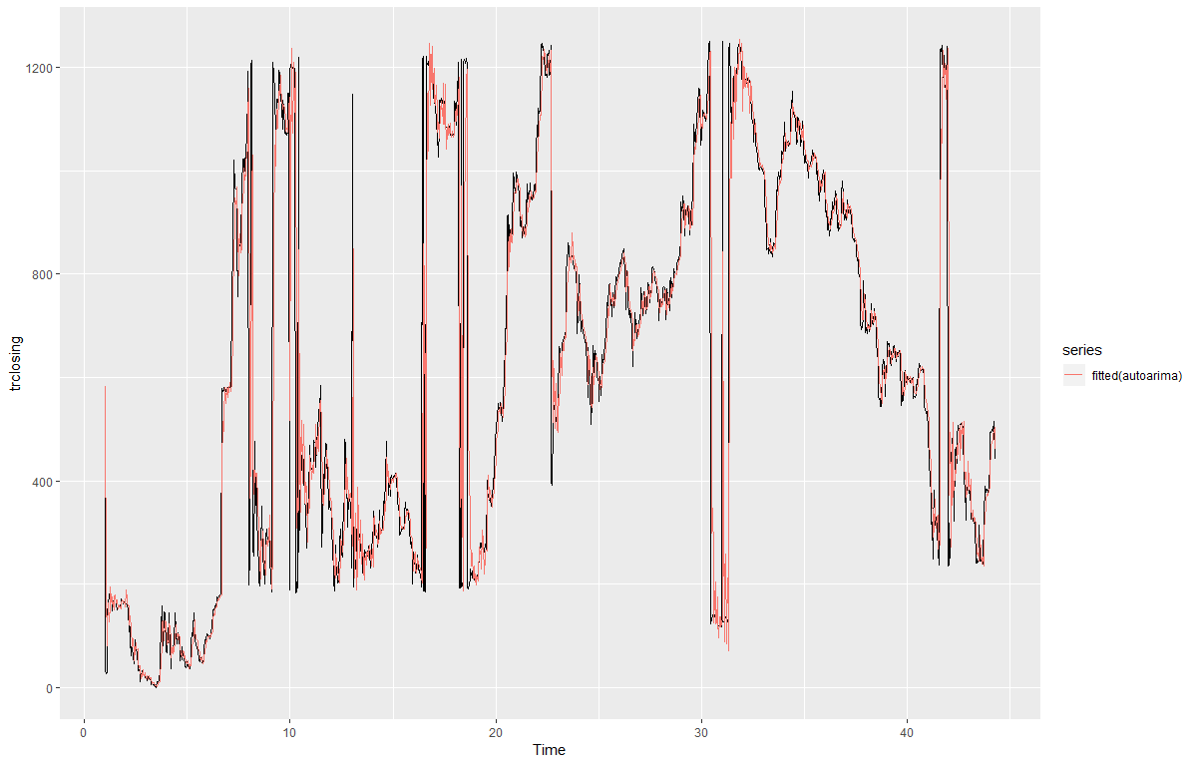
Arima(3,1,3) forecast

Slide 27
Test set Errors:
MODEL | ME | RMSE | MAE
MEAN | 3.3922 | 3806.81 | 3298
NAIVE | -24.44 | 1715 | 1221
SNAIVE | 1239 | 5087.55 | 3820
EXPONENTIAL SMOOTHING | 12.1972 | 37.22948 | 29.5008
AUTO-REGRESSION | -64.5679488 | 68.28193 | 64.56795
ARIMA | 10.13804997 | 39.0764 | 32.4061
ADL | -3.15482 | 58.87 | 43.73574

Slide 28
CONCLUSION
From principle of parsimony we found out that exponential smoothing predicts the Ethereum prices which are most close to the actual values. But market sentiments dominate the prices to a very large extent and accurately predicting future Ethereum prices is very difficult.

